Slide 1
Sales Prediction using Machine learning Algorithms
Done by
Vishweshwar Reddy Veerannagari
vishlu6@iastate.edu

Slide 2

Why do we need to Predict the data

Slide 3
Forecasting provides -
Managing of Work Force
In-Out flow of Cash
Decision-making can be done more precisely
Formulate a business plan effectively

Slide 4
Problem Statement
Nowadays Big shopping malls and Marts keep the track of their sales data for each and every individual item for predicting future demand of the customer and updating the inventory management as well.
These data stores basically contain a large number of customer data and individual item attributes in a data warehouse
Further anomalies and frequent patterns are detected by mining data from the data warehouse.
The resultant data can be used for predicting future sales volume with the help of different ML techniques for Big Malls.
A comparative analysis of existing model with other in terms of performance Metrix is used for analysis.

Slide 5
Collection and Segregation of Data.
The entire data set consists over 1400 data points.(Data set from Kaggle).
Out of which the data set is divided into
Training set-60%(around 8000 data points)
Validation set-20%
Testing set-20%

Slide 6
Expected Procedures
HYPOTHESIS GENERATION
DATA EXPLORATION
DATA CLEANING
FEATURE ENGINEERING
MODEL BUILDING
ARCHITECTURE

Slide 7

HYPOTHESIS GENERATION
Understanding the problem better by brainstorming possible factors that can impact the outcome.

Slide 8
Store level Hypothesis
City Type: Stores located in urban or Tier-1 should have higher sales due to the higher income levels of the people there.
Population Density: Stores located in densely populated areas should have higher sales due to more demand.
Store Capacity: Stores which are very big in size should have higher demands as they act like one-stop shops and people would prefer getting everything from one place.
Customer Behaviour: Stores keeping the right set of products to meet the local needs of customers will have higher sales.

Slide 9
DATA EXPLORATION
Looking at the categorical and continuous feature summaries and making inferences about the data.

Slide 10
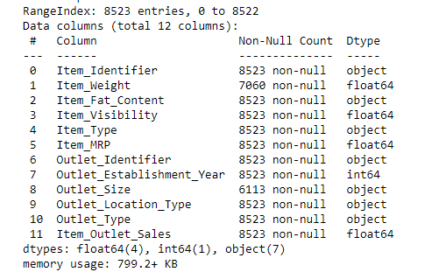
Data Exploration
Here we will be performing some data exploration and come up with some inferences about data. We will also figure out some irregularities (like missing values, zero values, and Null values) present in the data and address them according to the functionalities.
Data.info()

Slide 11
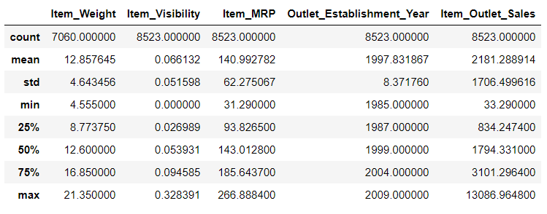
Here if you see most of the values in the training data set are non-null, whereas the values of ‘Item_weight’ and ‘Outlet_size’ have some null values which need to be addressed. Some of the values in ‘Item_Visibility’ are marked down as ‘0’ which might not be a null value but will definitely affect the accuracy of the model. Moreover from the 12 features present in the data 5 are numeric and 7 are categorial. Data.describe()

Slide 12
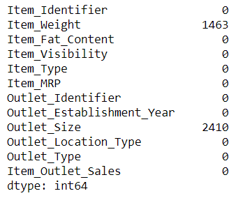
To check which identifier has null values and the total count of the null values. Data.isnull().sum()

Slide 13

DATA CLEANING
Imputing the missing values in the data and checking for outliers.

Slide 14
DATA CLEANING
This step critically involves imputing the missing values and treating the outliers. Though outliers removal is very important in regression techniques, advanced tree-based models are impervious to outliers.
So imputing the missing values for ‘Item_Weight’ and ‘Outlet_size’.
Replacing the zero values present in the ‘Item_Visibility’ with suitable data.

Slide 15
So to fill out the missing values present in the data we compute the mean, median, and mode of the data and replace the missing values according to their category and suitable variable.
Here we apply
data['Item_Weight']=data['Item_Weight'].fillna(data['Item_Weight'].mean())
data['Outlet_Size’]=data['Outlet_Size'].fillna(data['Outlet_Size'].mode()[0])

Slide 16
Removing the Outliers:
Generally there will be some data that may not be useful for analysis and model building, identifying outliers and removing them from the data set will create a noticeable difference when the data set trained using a regression model.
Such data outliers present in our data set are:
‘Item_Identifier’ and ‘Outlet_Identifier’
data.drop(['Item_Identifier','Outlet_Identifier'],axis=1,inplace=True)

Slide 17

FEATURE ENGINEERING
Modifying existing variables, and values and creating new variables along with values for model building and analysis.

Slide 18
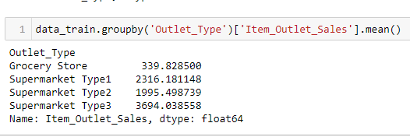
We explored some nuances in the data during data exploration section. Now let’s move on to resolving them and making our data ready for analysis. Here we will also create new variables using the existing ones from the data set.
Step-1
During Exploration, we decided to consider combining the supermarket type-2 and supermarket type-3 variables.
But is that a correct choice?
To check that, analyze the mean sales by type of the store. If they have similar sales, then keeping separate won’t help much.

Slide 19
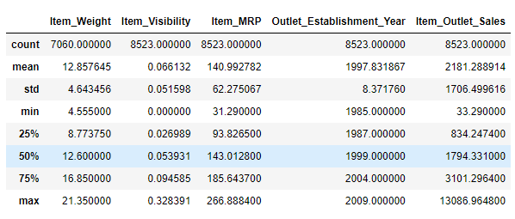

Step-2: Modify ‘Item_Visibility’ Here if you take a look, the minimum value here is 0, which makes no practical sense. So, lets consider it like missing information and impute it with mean value of the column ‘Item_Visibility’.

Slide 20
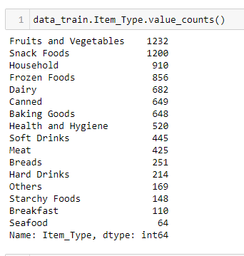
Step-3: Creating a broad category of type of Item.
We have seen the ‘Item_Type’ variable has 16 categories which might prove to be very useful in analysis.
So, it will be a good idea to combine them. One way could be manually assigning a new category to each.
But, if you observe the data column of
‘Item_Identifier’ i.e unique ID of each item
starts with either
FD=> consider it as a Food
DR=> as Drinks
NC=> as Non-consumables

Slide 21
Step-4: Categorial Variable Transformation
Here we use one hot encoding.
Earlier in data exploration, out of 12 features there are 7 Categorical variables to build a suitable model, the variable type of the entire data set is preferred. One hot encoding can be used here to achieve this.
Basically we perform one hot encoding to convert categorical values into numerical values which will further provide ML algorithms to do a better job in prediction and result in higher accuracy.

Slide 22
Model Building
Making predictive models on data.

Slide 23
Segregation of Train and Test Data
Segregating the data into train and test for model prediction
Code:
from sklearn.model_selection import train_test_split
x_train,x_test,y_train,y_test = train_test_split(x,y,test_size=.40, random_state=0)

Slide 24
Linear Regression
from sklearn.linear_model import LinearRegression
from sklearn.metrics import mean_squared_error
from sklearn.metrics import r2_score
model = LinearRegression()
model.fit(x_train, y_train)
# predicting the test set results
y_pred = model.predict(x_test)
mse = mean_squared_error(y_test, y_pred)
plt.plot(y_test[0:10], y_pred[0:10])
print('RMSE :', np.sqrt(mse))
print('Variance score: %.2f' % r2_score(y_test, y_pred))

Slide 25
Random Forest
from sklearn.ensemble import RandomForestRegressor
Parameters tuning
n_estimators=200, max_depth=5, min_samples_leaf=100, n_jobs=4
regressor.fit(x_train,y_train)
B_pred=regressor.predict(test_data)
mse = mean_squared_error(y_test, y_pred)
print("RMSE :",np.sqrt(mse))

Slide 26
Gradient Boosting Algorithm
from sklearn.ensemble import GradientBoostingRegressor
Parameter tuning:
N-estimators: 250, Max_depth: 5, Learning_rate: 0.01
mse = mean_squared_error(y_test, y_pred)
plt.plot(y_test, y_pred)
print('RMSE :', np.sqrt(mse))

Slide 27
DECISION TREE
knn = KNeighborsRegressor(n_neighbors=10)
knn.fit(x_train,y_train)
y_pred = knn.predict(x_test)
mse = mean_squared_error(y_test, y_pred)
plt.plot(y_test, y_pred)
print('RMSE :', np.sqrt(mse))

Slide 28
RSME values of Algorithms
Linear Regression | 1243.82
Random Forest | 1226.40
Decision Tree | 1149.11
Gradient Boosting Regressor | 1099.02

Slide 29
RESULTS
Various machine learning algorithms like
Linear Regression
Random Forest
Decision Tree
Gradient Boost has been built to predict the sales revenue of marts and malls. It’s been found that the most efficient algorithm to predict the sales revenue is observed with Gradient Boosting, and Decision Tree algorithms have the least RMSE value compared to Linear Regression, and Random Forest algorithms.

Slide 30
FUTURE SCOPE
Multiple instances of parameters and various factors can be used to make this sales prediction more innovative and successful.
Accuracy, which plays a key role in prediction-based systems, can be significantly increased as the number of parameters used is increased.
The project can be further collaborated in a web-based application with in-built intelligence by virtue of the Internet of Things (IoT), to be more feasible for use.
When combined with effective data mining methods and properties, the traditional means could be seen to make a higher and positive effect on the overall development of the corporation’s tasks.

Slide 31
CONCLUSION
Basics of machine learning and the associated data processing and modeling algorithms have been described, followed by their application for the task of sales prediction in Big Mart shopping centers at different locations.
On implementation the prediction results show the correlation among different attributes considered and how a particular location of medium size recorded the highest sales.
Now it is evident in a way we can recommend other shopping locations should follow similar patterns for improved sales.

Slide 32
THANK YOU Vishweshwar Reddy Veerannagari

